Slide 1
Fast Fingers: Typing Speed Tester A Project by G. Kedara Sai Adithya & Team

Slide 2
INTRODUCTION
OBJECTIVE
WHY C,DSA
ALGORITHM
LESSON LEARNT
IMAGES
OUTPUT

Slide 3
Team Details :-
Role | Name | Roll Number
Team Lead | G. Kedara Sai Adithya | 24K1A05G0
Member | G. Masthan | 24KB1A05J2
Member | G. Lokesh | 24KB1A05J8
Member | B. Lakshmi Narayana | 24KB1A0574
Notes:
Team Details

Slide 4
Introduction ->Typing speed is an essential skill in today’s digital world. ->This project tests the user’s typing speed by measuring time taken and accuracy. ->It helps users practice typing and improve both speed and precision. ->The program is simple, interactive, and beginner-friendly.

Slide 5
Objective
To develop a console-based application to measure typing speed.
To calculate Words Per Minute (WPM) and typing errors.
To strengthen programming concepts using C language and Data Structures.
To provide a real-time typing practice tool.

Slide 6
Why C Language and DSA? C Language : Provides low-level control and high performance. Efficient handling of time functions and string operations. Data Structures And Algorithm(DSA): Essential for managing input, processing time, and error calculations efficiently. Improves problem-solving and logical thinking skills.

Slide 7
Algorithm for Typing Speed Tester Program
Step 1 —> Start the program.
Step 2 —> Declare variables:
—>A predefined sentence for typing.
—>A string to store user input.
—>Variables for counting mistakes, words, and time.
Step 3 —> Display the predefined sentence to the user.
Step 4 —> Record the start time using time() function.
Step 5 —> Take user input using fgets() function.
Step 6 —> Record the end time using time() function.
Step 7 —> Remove the trailing newline character from user input if it exists.
Step 8 —> Calculate the time taken to type:
—>Use difftime(end_time, start_time) to find the difference in seconds.
Step 9 —> Count the number of mistakes:
—>Compare each character of the user input with the original sentence.
—>Increase the mistake counter for every mismatch.
Step 10 —> Count the number of words typed:
—>Count the number of spaces in the input.
—>Add 1 to get the total number of words.
Step 11 —> Calculate Typing Speed (WPM):
—>Formula: WPM = (Number of Words × 60) ÷ Time Taken (in seconds)
Step 12 —> Display the results:
—>Time Taken
—>Words Typed
—>Number of Mistakes
—>Typing Speed (WPM)
—>End the program.

Slide 8
Lesson Learnt
—>Improved understanding of time-based functions in C. —>Hands-on experience in error-checking and string manipulation.
—>Learned how DSA helps in efficient and structured programming.
—>Enhanced debugging and logical reasoning skills.

Slide 9
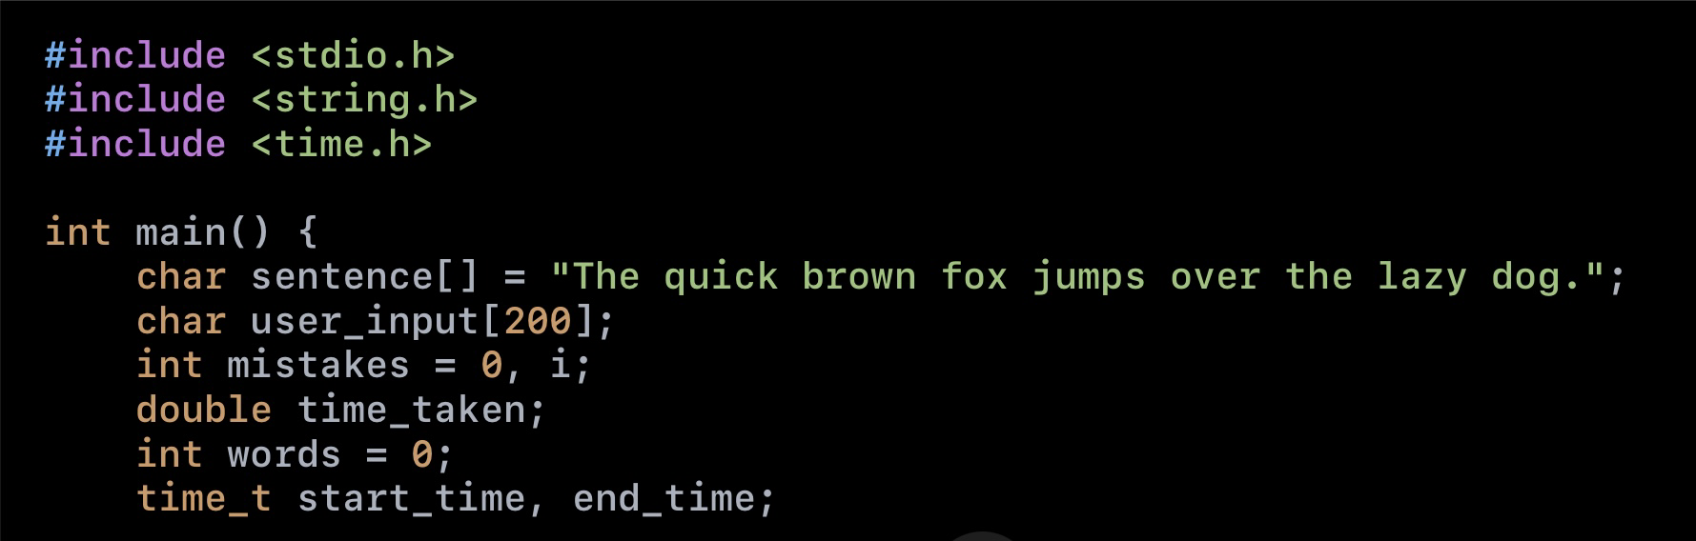
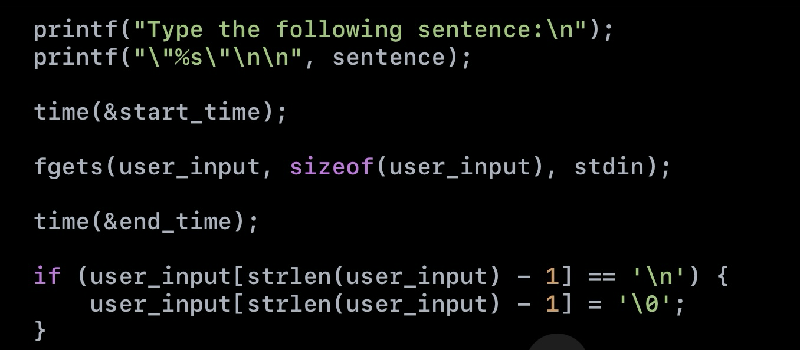
Images

Slide 10
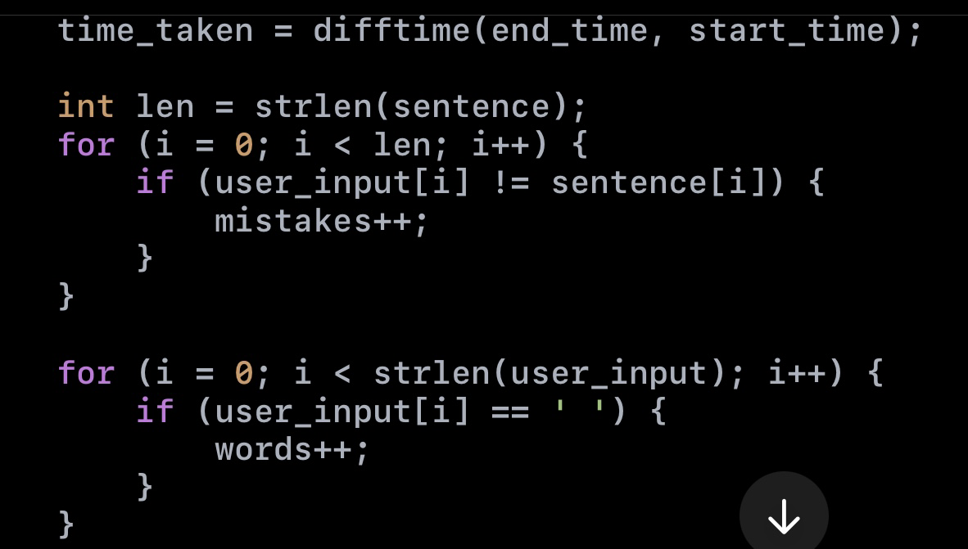
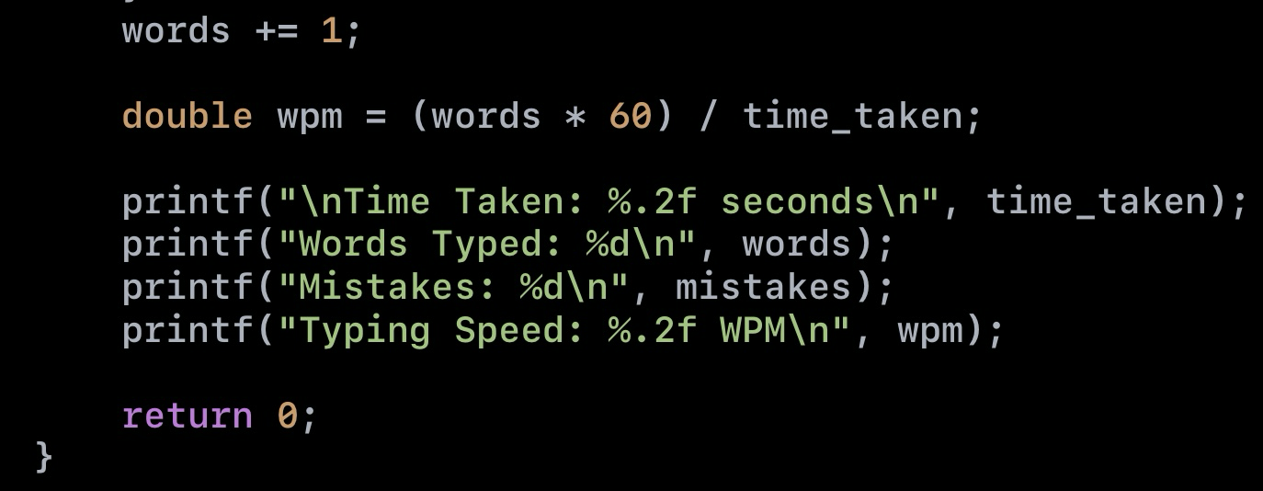

Slide 11
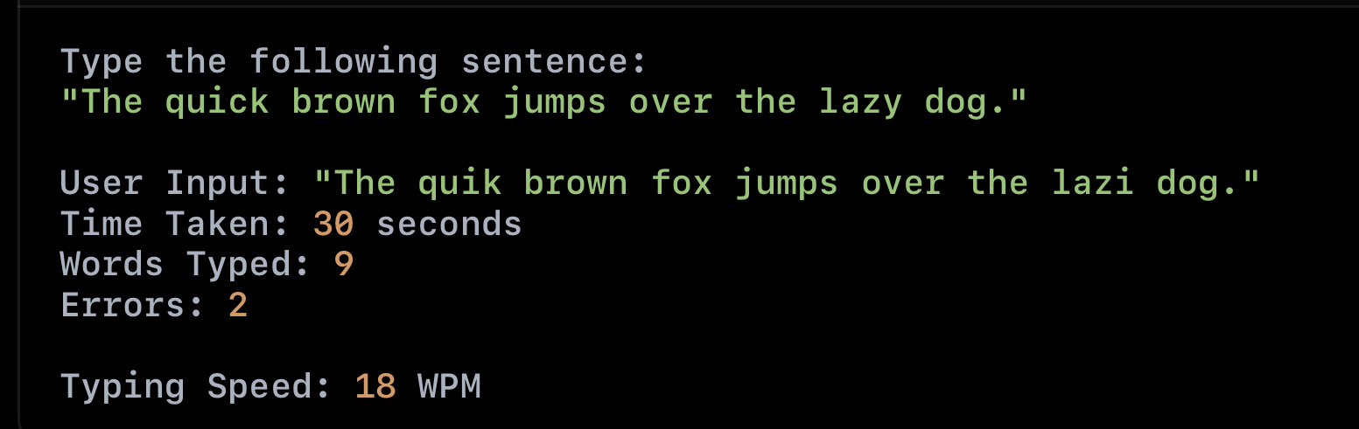
Output

Slide 12
Conclusion
We have successfully implemented the real time mini project on dsa for typing speed tester using linkedlist and functions
Thank you for your time and attention we are grateful for this opportunity to showcase our mini project with our colleagues

